Slide 1
SD card

Slide 2
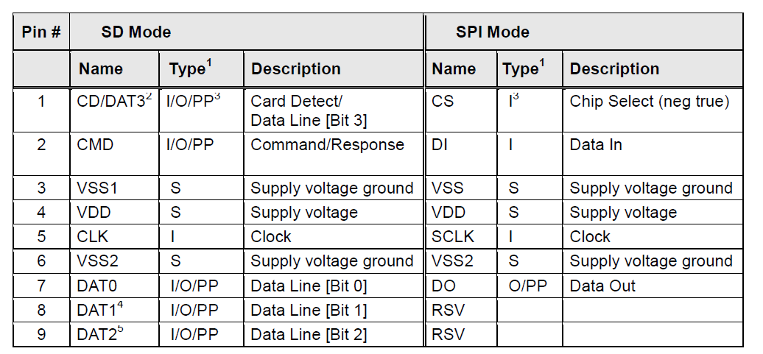
SD Protocol,

Slide 3
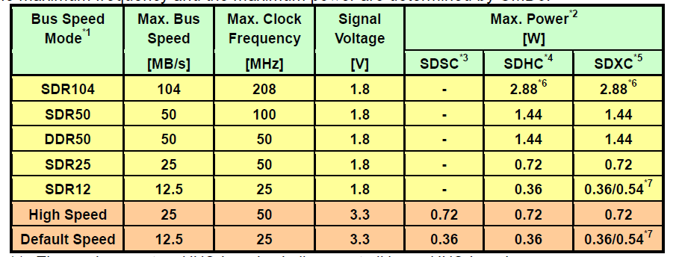
SD Protocol
UHS-I : four bits transfer ( SD bus)

Slide 4
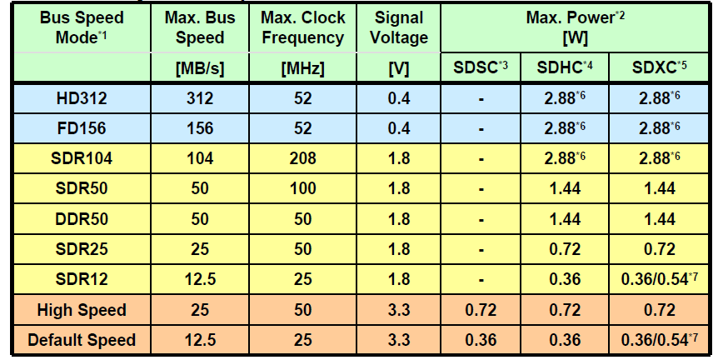
SD card
Ultra High Speed Phase II

Slide 5
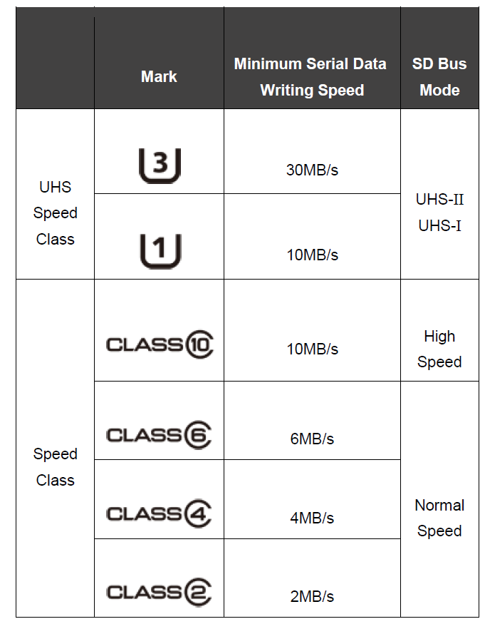
SD card: granteed speed

